Slide 1
DAY 8 PPT
SORTING ALGORITHMS

Slide 2
INSERTION SORT
Insertion sort is an algorithm used to sort a collection of elements in ascending or descending order. The basic idea behind the algorithm is to divide the list into two parts: a sorted part and an unsorted part.
Initially, the sorted part contains only the first element of the list, while the rest of the list is in the unsorted part. The algorithm then iterates through each element in the unsorted part, picking one at a time, and inserts it into its correct position in the sorted part.
To do this, the algorithm compares the current element with each element in the sorted part, starting from the rightmost element. It continues to move to the left until it finds an element that is smaller (if sorting in ascending order) or larger (if sorting in descending order) than the current element.
Once the correct position has been found, the algorithm shifts all the elements to the right of that position to make room for the current element, and then inserts the current element into its correct position.

Slide 3
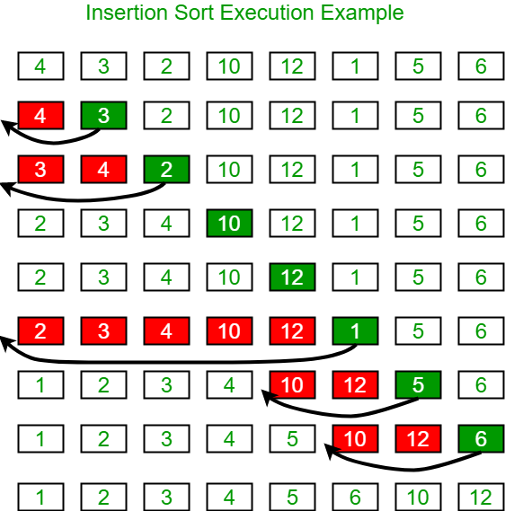
// Insertion sort in C
#include <stdio.h>
// Function to print an array
void printArray(int array[], int size) {
for (int i = 0; i < size; i++) {
printf("%d ", array[i]);
}
printf("\n");
}
void insertionSort(int array[], int size) {
for (int step = 1; step < size; step++) {
int key = array[step];
int j = step - 1;
// Compare key with each element on the left of it until an element smaller than
// it is found.
// For descending order, change key<array[j] to key>array[j].
while (key < array[j] && j >= 0) {
array[j + 1] = array[j];
--j;
}
array[j + 1] = key;
}
}
// Driver code
int main() {
int data[] = {9, 5, 1, 4, 3};
int size = sizeof(data) / sizeof(data[0]);
insertionSort(data, size);
printf("Sorted array in ascending order:\n");
printArray(data, size);
}

Slide 4
MERGE SORT
Merge Sort is a Divide and Conquer algorithm. It divides the input array into two halves, calls itself for the two halves, and then it merges the two sorted halves.
The merge() function is used for merging two halves. The merge(arr, l, m, r) is a key process that assumes that arr[l..m] and arr[m+1..r] are sorted and merges the two sorted sub-arrays into one.

Slide 5
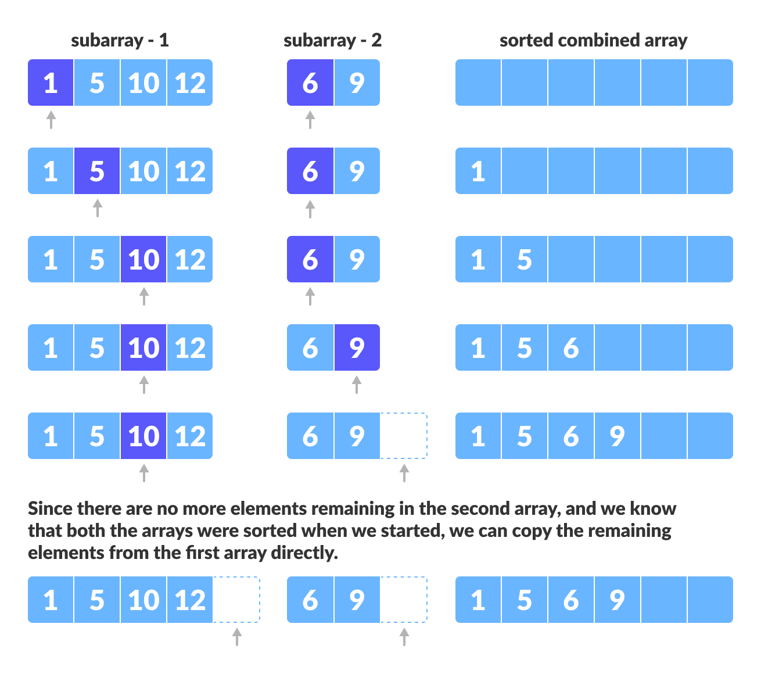

Slide 6
HEAP SORT
Heap sort is a comparison-based sorting technique based on Binary Heap data structure. It is similar to the selection sort where we first find the minimum element and place the minimum element at the beginning. Repeat the same process for the remaining elements.
Heap Sort Algorithm
To solve the problem follow the below idea:
First convert the array into heap data structure using heapify, then one by one delete the root node of the Max-heap and
replace it with the last node in the heap and then heapify the root of the heap. Repeat this process until size of heap is
greater than 1.
Build a heap from the given input array.
Repeat the following steps until the heap contains only one element:
Swap the root element of the heap (which is the largest element) with the last element of the heap.
Remove the last element of the heap (which is now in the correct position).
Heapify the remaining elements of the heap.
The sorted array is obtained by reversing the order of the elements in the input array.

Slide 7
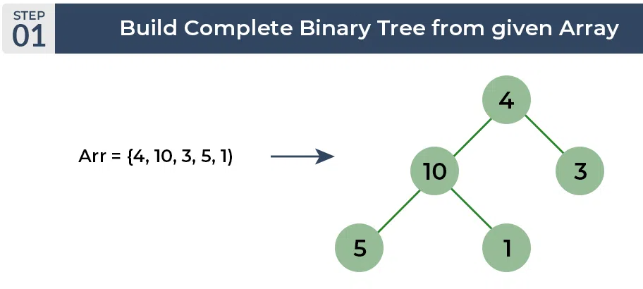
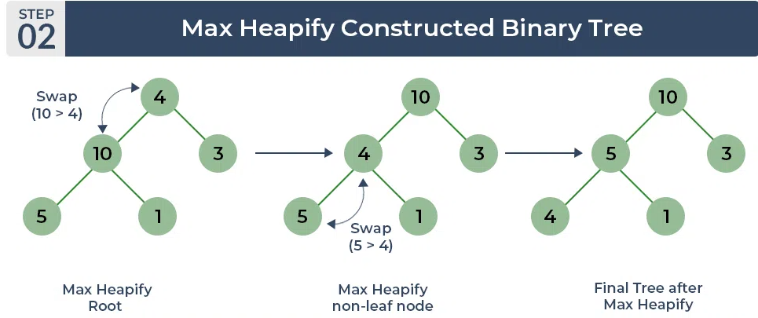
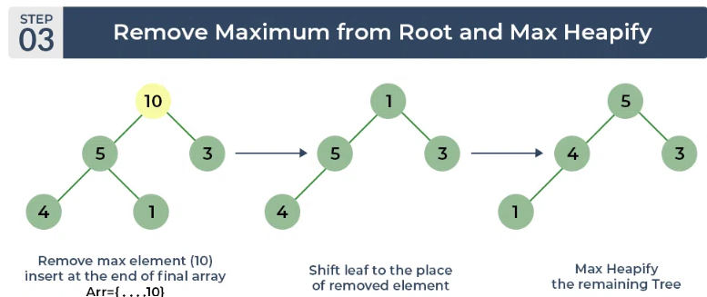
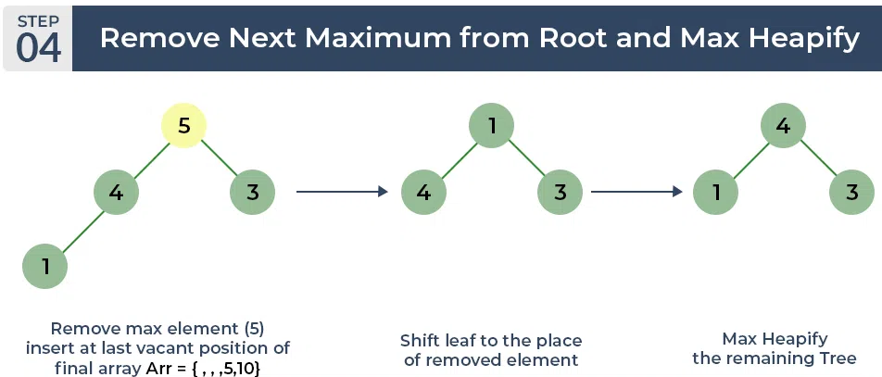
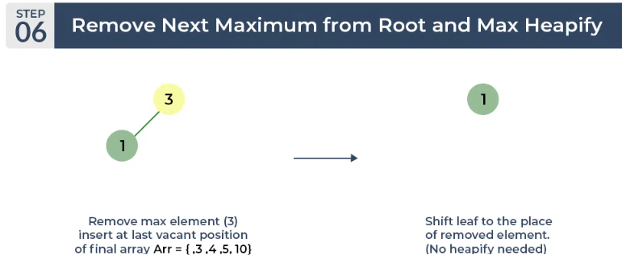
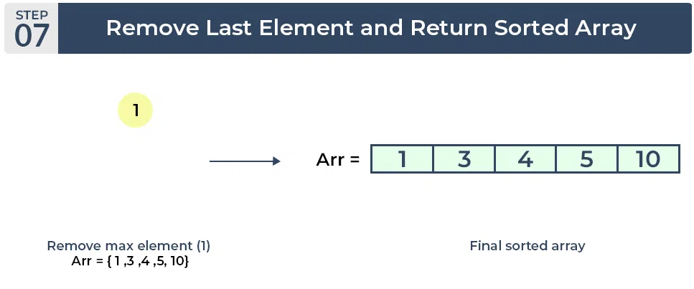

Slide 8
BUBBLE SORT
Bubble Sort is the simplest sorting algorithm that works by repeatedly swapping the adjacent elements if they are in the wrong order. This algorithm is not suitable for large data sets as its average and worst-case time complexity is quite high.
Bubble Sort Algorithm
In Bubble Sort algorithm,
traverse from left and compare adjacent elements and the higher one is
placed at right side.
In this way, the largest element is moved to the rightmost end at first.
This process is then continued to find the second largest and place it and
so on until the data is sorted.

Slide 9
Time Complexity: O(N²) Auxiliary Space: O(1)
Advantages of Bubble Sort:
Bubble sort is easy to understand and implement.
It does not require any additional memory space.
It is a stable sorting algorithm, meaning that elements with the same key value maintain their relative order in the sorted output.
Disadvantages of Bubble Sort:
Bubble sort has a time complexity of O(N²) which makes it very slow for large data sets.
Bubble sort is a comparison-based sorting algorithm, which means that it requires a comparison operator to determine the relative order of elements in the input data set. It can limit the efficiency of the algorithm in certain cases.

Slide 10
